Slide 1
Test Automation Aggreko
Hussein Gadalla

Slide 2
Download JDK , JRE
https://www.oracle.com/java/technologies/javase/javase-jdk8-downloads.html
Add a JAVA_HOME environment variable to your system that points to where the JDK is installed

Slide 3
Download Eclipse for java developers
https://www.eclipse.org/downloads/packages/

Slide 4
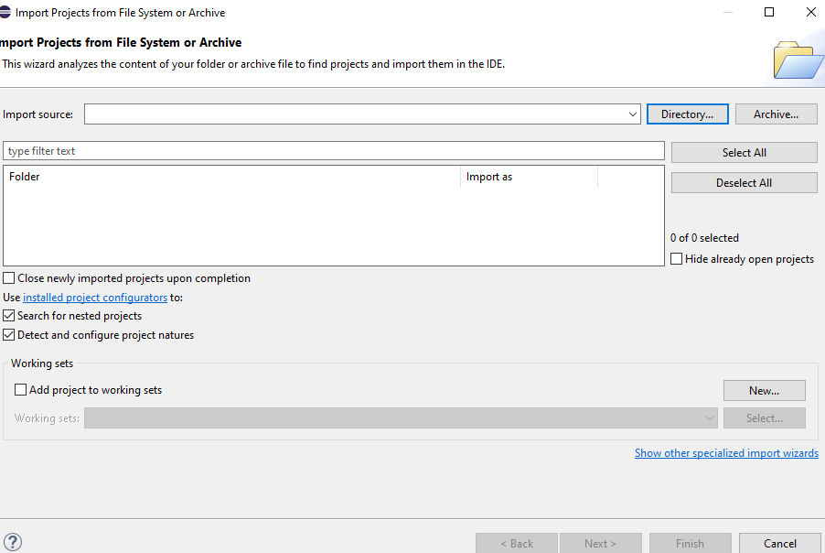
Import the project to eclipse

Slide 5
Import the project
Navigate into your system and choose the directory of the project
The Directory of the project without expanding it just point to the directory of the project to import the whole project

Slide 6
Install TestNG from market place
Click help at the top of the page
Then eclipse market place
Search for TestNG for eclipse
Install TestNG

Slide 7
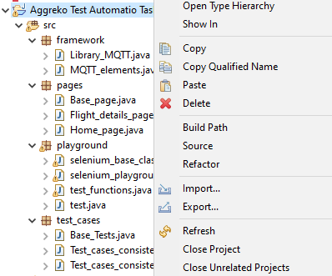
Add Sikuli and selenium jar files
Select the project name from eclipse then right click then choose properties

Slide 8
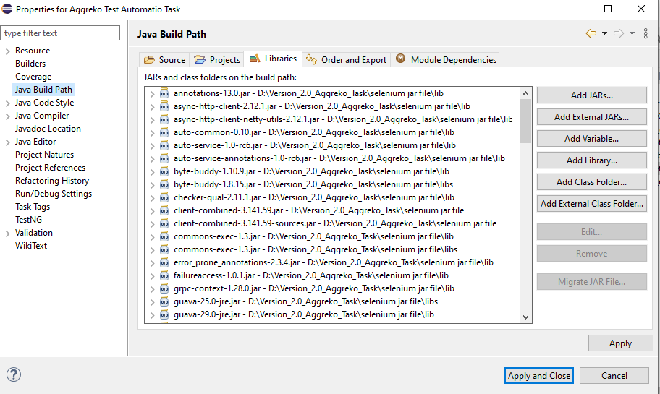
Add Sikuli and selenium jar files
Choose Java build path

Slide 9
Add Sikuli and selenium jar files
Click on the libraries tab at the top of page if not selected by default
Delete all the external jar files added as they point to wrong location relative to your machine
leave JRE system library only as it is not external jar file

Slide 10
Add selenium jar files
Click on add external library at the right hand side of the page if not selected
Inside the project directory a folder named selenium jar file ..open it
Add all the jar files found as well as jar files inside lib folder and libs folder

Slide 11
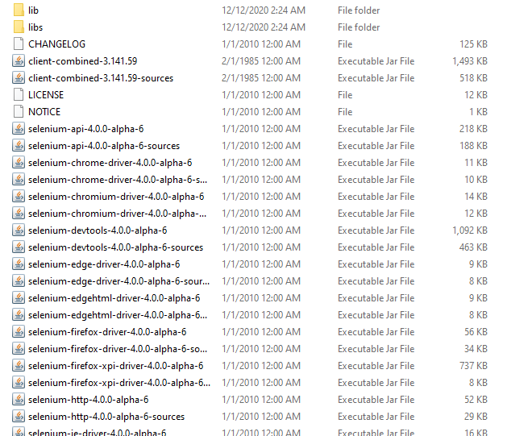

Slide 12
Add Sikuli
Inside the project directory a folder named Jar_files..open it
Add the only Sikuli jar file found inside the folder

Slide 13
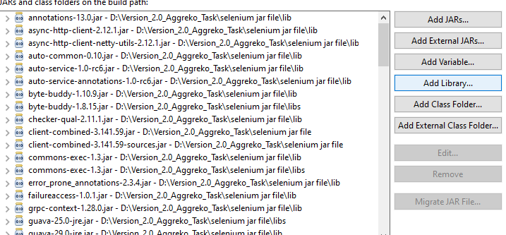
Add TestNG to the project
At the right hand side of java build path page click add library tab

Slide 14
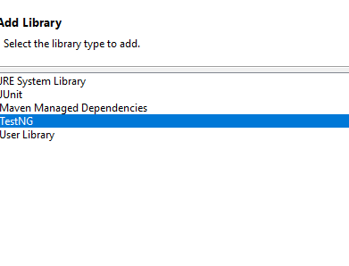
Add TestNg

Slide 15
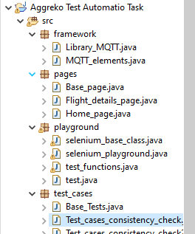
Choose Test case to run
From Test case package choose Test_cases_consistency_check

Slide 16
Update the MQTT.FX.exe location
A variable pointing to the location of MQTT.fx.exe has to be updated. Variable name is “MQTT_FX_target_path”
Replace the value "C:\\Users\\hussein.gadallah\\AppData\\Local\\Programs\\mqttfx“ with the value updated

Slide 17
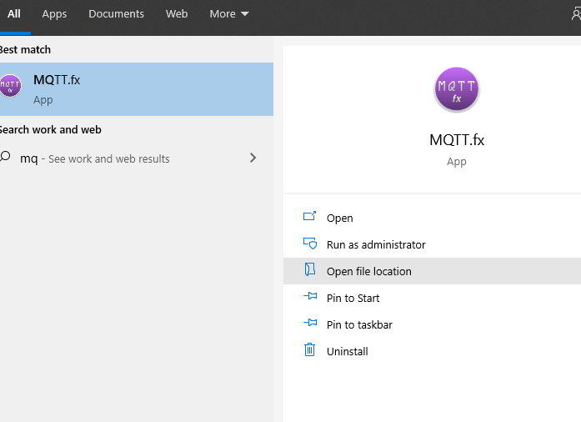
Steps to get the path of the MQTT.fx

Slide 18
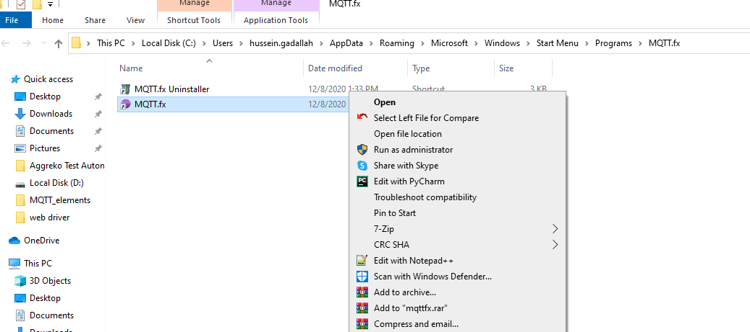
Steps to get the path of the MQTT.fx
Right click on the MQTT.fx purple icon then select properties

Slide 19
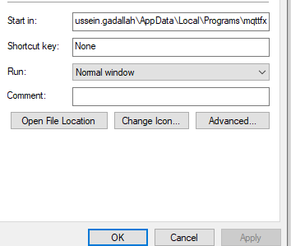
Steps to get the MQTT.fx path
Copy the path inside start in input filed

